Slide 1

YELP DATA ANALYTICS
What can YELP Data Analysts do for you?

Slide 2
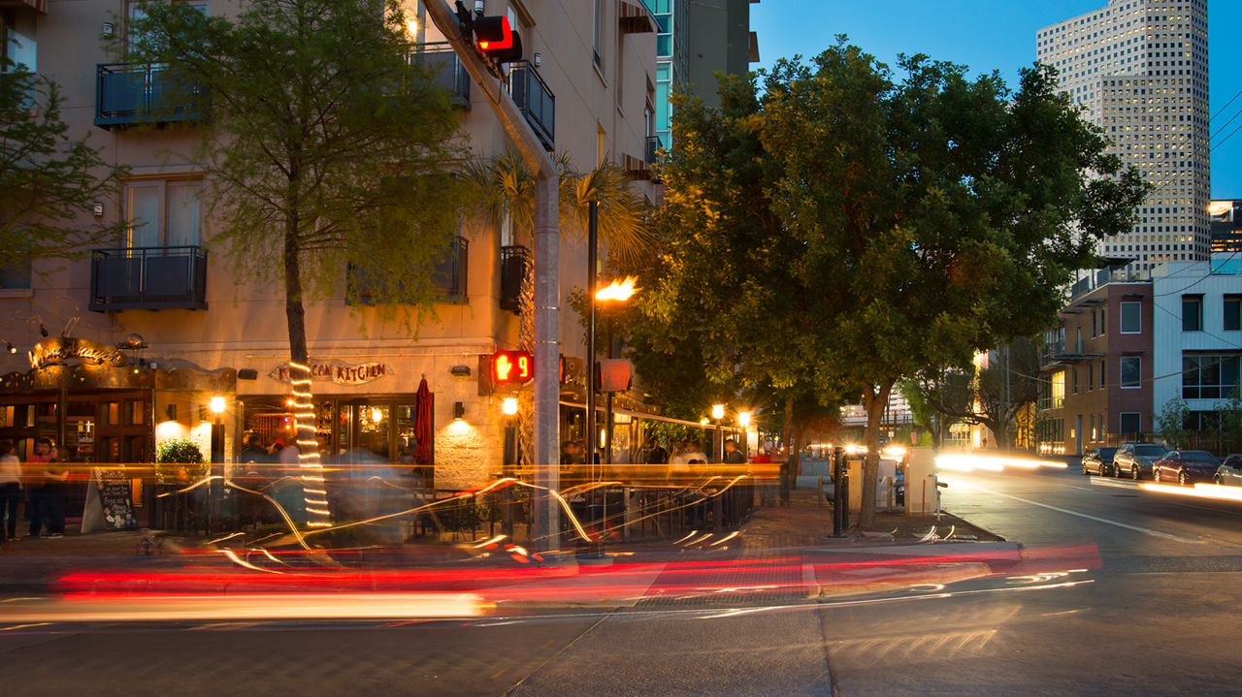
Our Team EMJB Analytics
Elie Hakim
Miguel Patxot
Jon Rinko
Ben Suh
Bringing data to life since 2019

Slide 3

Project Goals:
Determine which geographic area provides the best business opportunity
Determine which categories of food groups to include on their menu
Determine which areas have the most competition
A major client is looking to expand their restaurant empire to California, Texas, Illinois, or New York
Notes:
This slide looks like crap – fix later

Slide 4
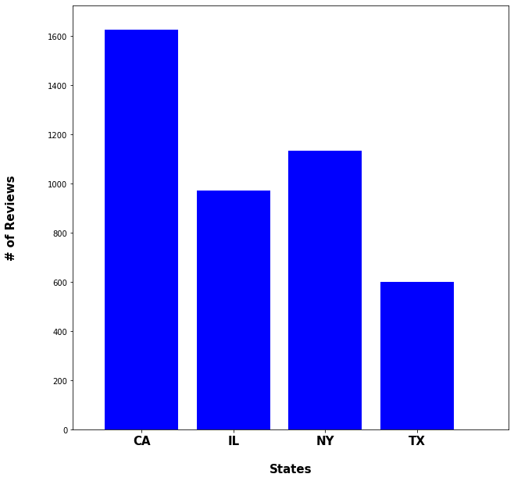
Average Reviews per Restaurant by State
Notes:
This data shows which states receive the most reviews or customers using yelp and reviewing their restaurant.
Assuming the overhead and upkeep for the restaurant is the same in each state, CA looks promising so far.

Slide 5
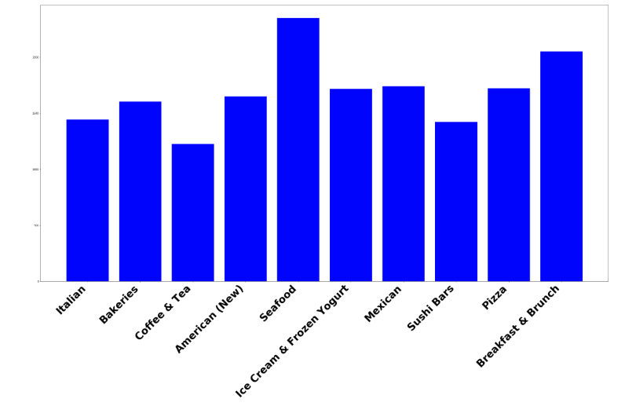
Top 10 Categories in San Francisco
Notes:
This data shows top 10 categories in CA.

Slide 6
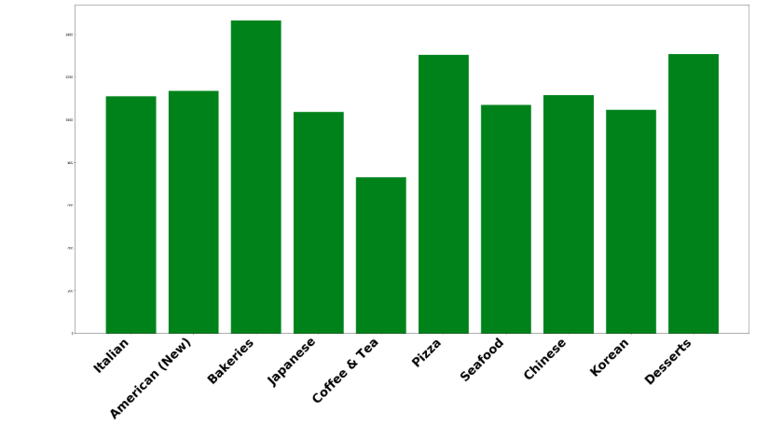
Top 10 Categories in New York City
Notes:
This data shows top 10 categories in NY

Slide 7
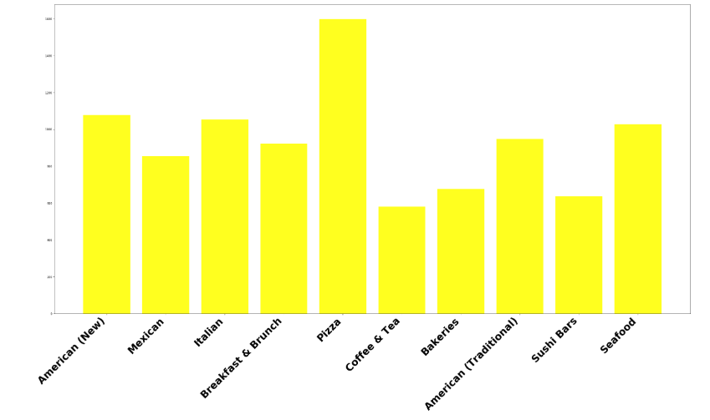
Top Ten Categories in Chicago, IL
Notes:
This data shows top 10 categories in CA.

Slide 8
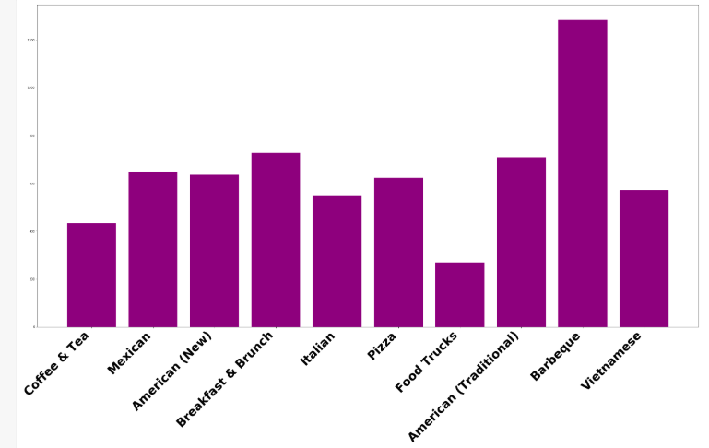
Top 10 Categories in Texas
Notes:
Clearly BBQ is #1 in Texas. American is actually a combination of New American and Traditional, but was combined during cleaning of the data. New American is often described as having more fusion.

Slide 9
Lessons learned from analysis:
The most reviews come from CA and then NY as these are some of the busiest cities in the country
Many of the most popular categories are similar regardless of location: Italian, American(New and Traditional), Breakfast, Mexican, Seafood, …
One thing that stands out from the analysis: TX is famous for BBQ
Based on the analysis, it appears CA has the most demand for a new restaurant and some of the most popular restaurants in CA are involve seafood and American fusion.

Slide 10
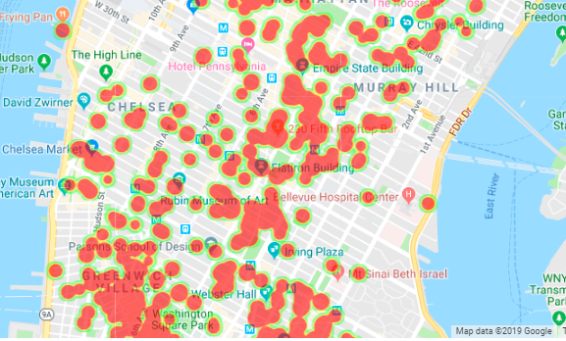
New York Heat Map By Rating
Where is our competition?
Will we be able to stand the heat?
Notes:
Using heatmaps of ratings with Google Maps we can take a closer look at our competition. We can see that the financial district is a popular location as well as Union Square.

Slide 11
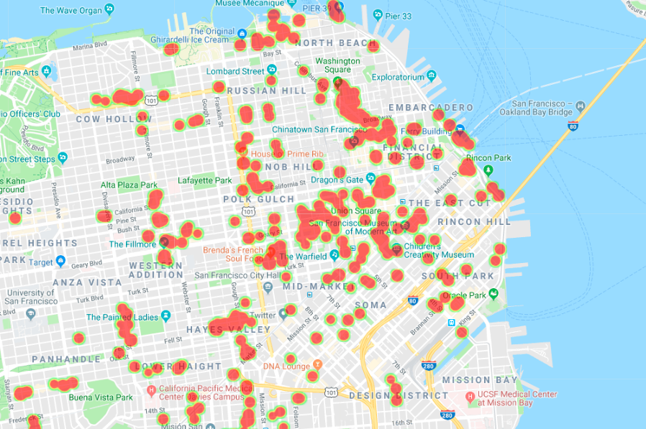
San Francisco Heat Map By Rating
Where is our competition?
Will we be able to stand the heat?
Notes:
Using heatmaps of ratings with Google Maps we can take a closer look at our competition. We can see that the financial district is a popular location as well as Union Square.

Slide 12
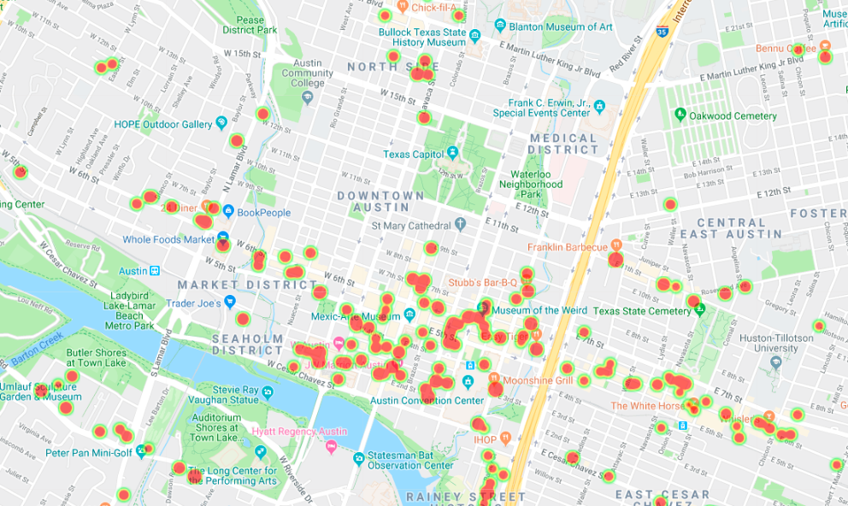
Austin, TX Heat Map By Rating
Where is our competition?
Will we be able to stand the heat?
Notes:
Using heatmaps of ratings with Google Maps we can take a closer look at our competition. We can see that the financial district is a popular location as well as Union Square.

Slide 13
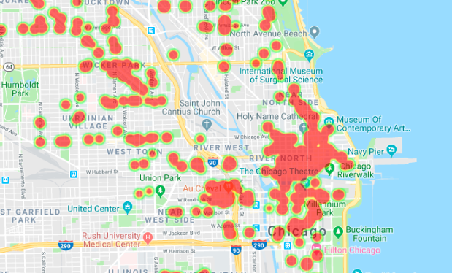
Chicago, IL Heat Map By Rating
Where is our competition?
Will we be able to stand the heat?
Notes:
Using heatmaps of ratings with Google Maps we can take a closer look at our competition. We can see that the financial district is a popular location as well as Union Square.

Slide 14
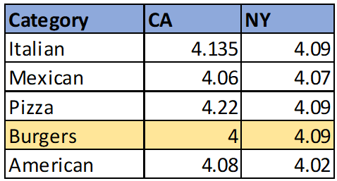
Client Recommendation:
Based on our analysis and our clients business model, we decided that it would be best to pursue expansion into the CA market, specializing in a Burger Restaurant
While CA is more competitive than other cities based on competitor ratings, they have less overall competition and it is a better fit with their current menu.

Slide 15
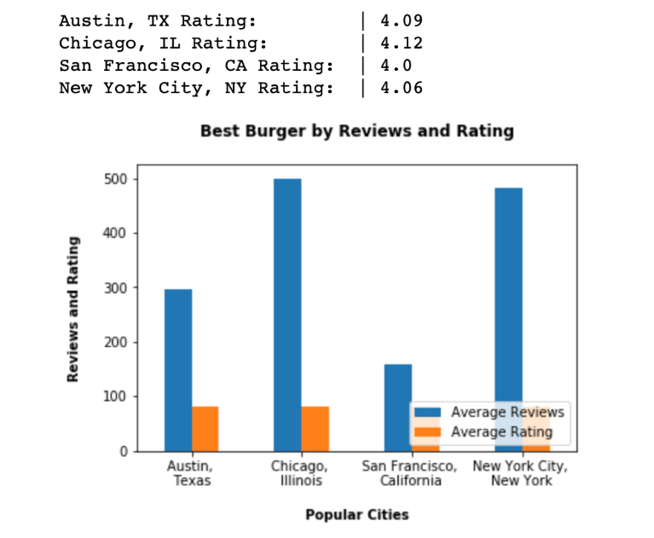
Market Analysis based on Business Counts and Ratings
The worst rated burgers are in California.
The best burgers were rated in Chicago.
Most American Style restaurants were located in Chicago.
The best burger scene would be experienced in Chicago, IL followed by New York City.
California would prove to be a better business venture to improve upon the quality of burgers just based on average ratings.

Slide 16
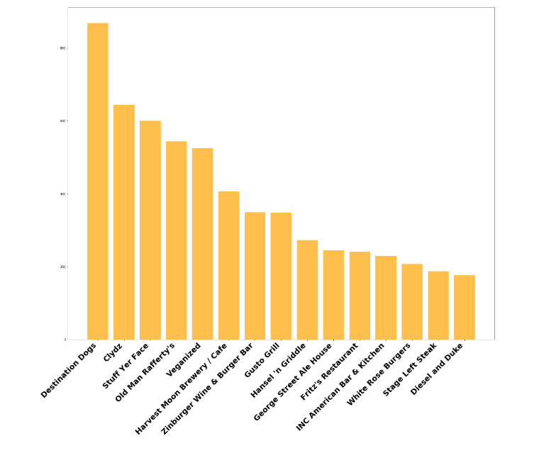
Best Burger in Town

Slide 17

Data Collection
Used YELP API json requests
Converted to CSV with python
Cleaned Data as needed
Grouped and graphed data
Notes:
We used the yelp API to sample NY, CA, TX, IL
We were able sample over 2500 businesses, & reviewed the ratings, price points, and categories.
We spent significant time cleaning the data, removing outliers that did not fit our search params.

Slide 18
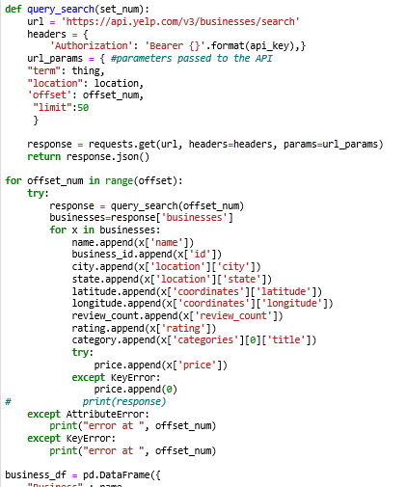
Data Collection Example
Notes:
We used the yelp API to sample NY, CA, TX, IL
We were able sample over 2500 businesses, & reviewed the ratings, price points, and categories.
We spent significant time cleaning the data, removing outliers that did not fit our search params.

Slide 19
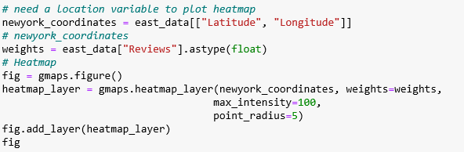
Data Collection Example
Notes:
We used the yelp API to sample NY, CA, TX, IL
We were able sample over 2500 businesses, & reviewed the ratings, price points, and categories.
We spent significant time cleaning the data, removing outliers that did not fit our search params.

Slide 20


THANK YOU

Slide 21

Questions?
Notes:
Questions?

